Slide 1
The ISO system and
ISO 21001
UM Welcomes ANSI CMF 2016
2016 May 11

Slide 2

About us
162 members
20 500
International Standards
100
new standards each month
More than
100 000 experts
229
technical committees
Founded in 1947
Independent
Non-governmental organization
Global network of national standards bodies*
One member per country
ISO membership comes with rights, benefits, obligations and good practice
*National standard body = national body most representative of standardization

Slide 3



ISO and the WSC
(World Standards Cooperation)
High level cooperation between IEC, ISO and ITU
All developing international standards
  IEC: electrical, electronic and related technologies
  ITU: telecommunications
  ISO: everything else! For example in the fields of quality, safety and security, general management, health and medical, environment and energy, industry, services, information technology

Slide 4
Membership of ISO committees
Active role
Voting obligation
Identify experts
Provide national delegations
Stakeholder engagement
Participating
members
Those who wish to follow
No voting rights
Can make contribution
But do not want to commit
Open to Member Bodies
Observing
members
For international & regional organizations
No voting rights
Participation or information
Help to ensure wider acceptance
Bring expertise
External
liaisons
With ISO and IEC committees
No voting rights
Participation or information
Internal
liaisons

Slide 5
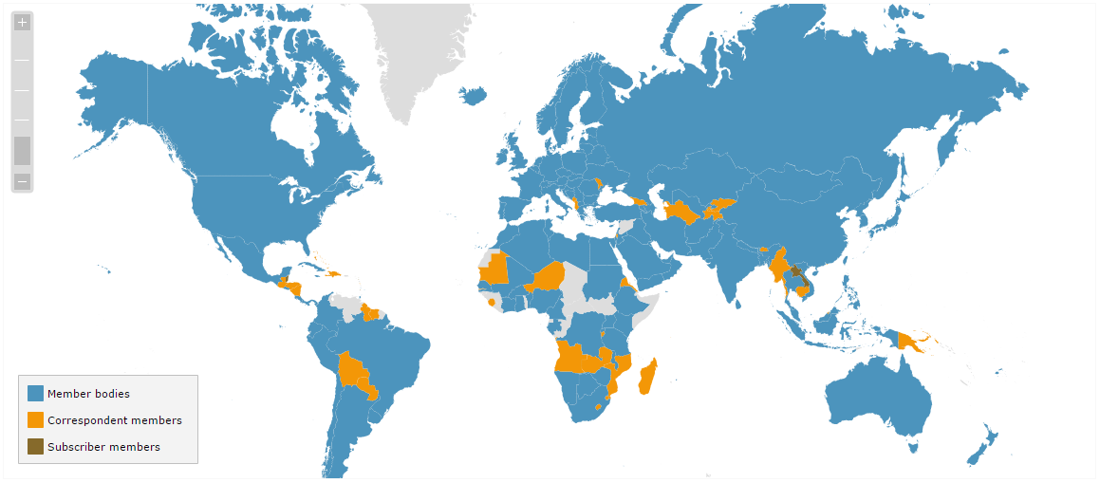
ISO members
119
39
4
As of February 2016 - http://www.iso.org/iso/home/about/iso_members.htm

Slide 6
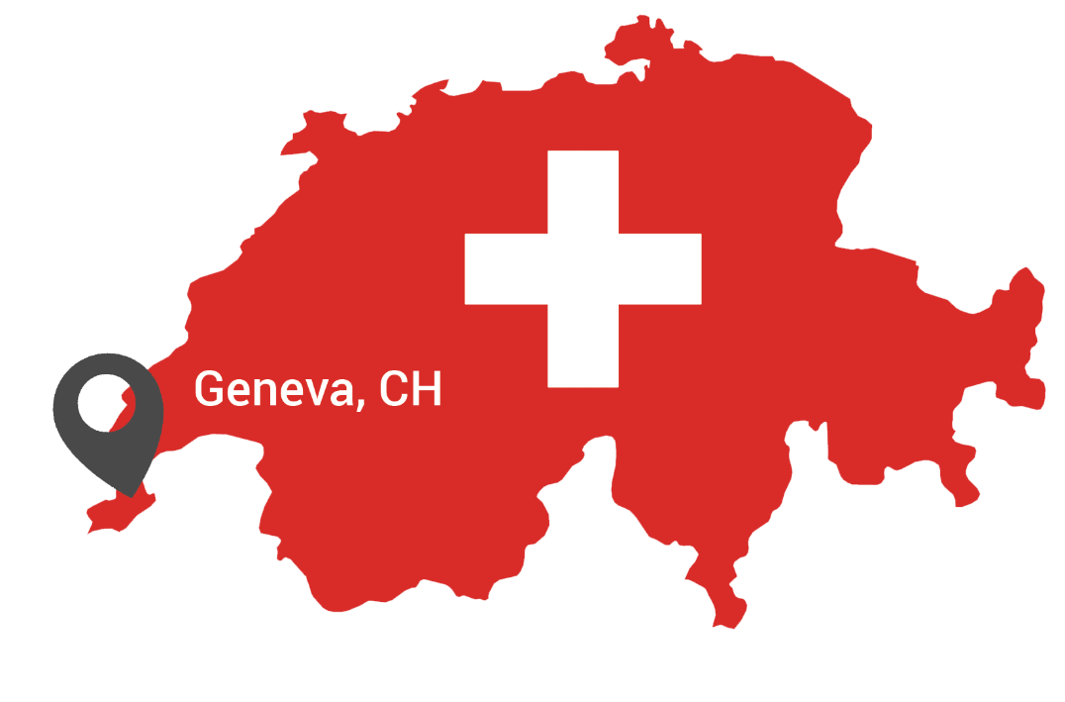


Central Secretariat
    Secretary General
    140 staff
        Coordinates the process
        Day to day operations
        Publishes International Standards
        Acts as secretariat for the governing bodies

Slide 7

Management structure
General Assembly
Council Standing Committees
Council
Policy Development Committees
COPOLCO
TMB
President’s Committee
DEVCO
CASCO
Technical Committees
ISO Central Secretariat
Reporting
Advisory

Slide 8
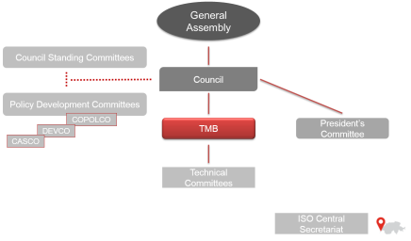
Technical Management Board (TMB)
      15 members from Member Bodies
      Elected for 3-year terms
      Represents the ISO’s community interest
      Meets 3 times /year
        Overall management of technical work
        Sets the rules for quality & efficiency
        Contributes to decisions on strategic issues
        Reports to the Council

Slide 9
TMB – Key tasks
Appointment of
Chairmen
Approval of titles &
scopes of TCs
Revisions of
ISO/IEC Directives
Establishment &
Dissolution of TCs
Reviewing of
ISO performance
Coordination, monitoring
& planning of new fields
Conflicts resolution
Appeals

Slide 10
ISO 21001
Educational organization management systems

Slide 11
What is ISO 21001?
A Management System Standard (MSS) that:
  Focuses on interactions between an educational organization, the learner, customers and other relevant interested parties
  Applies to all educational organizations that provide, share and facilitate the construction of knowledge to learners through teaching, training or research, regardless of type, size and product and service provided
ISO 21001 will be the result of work from 3 different standardizers communities:
  Quality specialists
  IT specialists
  Learning services specialists

Slide 12
Why ISO 21001?
The education sector globally:
Many national and regional regulations (laws)
Many national, regional and international
“private standards” (education industry practice)
Many national formal standards (e.g. Portuguese standard)
One international standard (ISO 9001)
ISO 21001 offers a common management tool for organizations providing educational products and services
Helping educational organizations deliver quality in today’s challenging educational environment
Offering guidelines to help organizations meet requirements of learners and other customers

Slide 13
Challenges faced by ISO 21001
Wide scope:
From kindergarten to post-doc
Including vocational education and training
Including face to face and distance learning
Multitude of support services
Libraries
Counseling (cognitive, vocational, professional)
Restaurants, cafeteria, cantines, etc.

Slide 14
Challenges faced by ISO 21001
Accreditation & certification:
Need for highly qualified audit teams
Difficult to achieve a cost-efficient balance regarding the audit’s durations

Slide 15
ISO 21001 development
Sept 2014
1st meeting of PC 288
2015
2016 Q4
Sept 2013
Concept agreement
Working Groups meetings
(3 face to face, 2 Webex)
CD & DIS ballot
2017 Q3
Possible FDIS in 2017 Q1
Publication

Slide 16
Benefits of ISO 21001
Ensures better alignment of educational mission, vision, objectives and action plans
Inclusive and equitable quality education for all
Facilitating self-learning and lifelong learning opportunities
Enabling more personalized learning and effective response to special educational needs
Consistent processes and evaluation tools to demonstrate and increase effectiveness and efficiency
Increased credibility of the educational organization

Slide 17
Benefits of ISO 21001
Recognized means to enable organizations to demonstrate commitment to education management practices in the most effective manner
Provides a model for improvement
Harmonization of national standards within an international framework
Widened participation of interested parties
Stimulation of excellence and innovation

Slide 18
Structure of ISO 21001
ISO 21001 will adopt the High Level Structure:
Management terms and definitions (21) will be common to existing high profile ISO standards (ISO 9001, ISO 14001, ISO 27001…)
The structure will be identical to that of other ISO management system standards (more than 30 and growing). Some important text and core concepts will also be identical.
ISO 21001 composed of a main text and annexes to help covering the wide scope.

Slide 19
Structure of ISO 21001
Scope
Normative references
Terms and definitions
Context of the organization
Leadership
Planning
Support
Operation
Performance evaluation
Improvement
Notes:
4.1 Understanding the educational organization and its context
4.2 Understanding the needs and expectations of interested parties
4.3 Determining the scope of the EOMS
4.4 The EOMS and its processes
5.1 Leadership and commitment
5.2 Vision, mission, strategy and policy
5.3 Organizational roles, responsibilities and authorities
6.1 Actions to address risks and opportunities
6.2 The educational organization's objectives and planning to achieve them
6.3 Planning of changes
7.1 Resources
7.2 Competence
7.3 Awareness
7.4 Communication
7.5 Documented information
8.1 Operational planning and control
9.1 Monitoring, measurement, analysis and evaluation
9.2 Internal audit
9.3 Management review
9.4 Self-assessment
10.1 General
10.2 Nonconformity and corrective action
10.3 Continual improvement

Slide 20
Structure of ISO 21001 - Annexes
Annex A (normative): Principles for education organizations management mystem (EOMS)
Annex B (normative): Classification of interested parties
Annex on distance learning
Annex on special needs education (including gifted children)
Possible further annexes:
Annex on research
Annex on early childhood education

Slide 21
Who will benefit from ISO 21001?
Learners
All types of educational organizations (public, private, self-sufficient, non-profit)
Interested parties and stakeholders (teachers, parents, Government, NGOs, trade unions, etc.)

Slide 22
Who’s developing ISO 21001?
International cross-sectorial expert group
93 experts from 32 national standardization bodies
Liaisons with others ISO Committees
Liaisons with external organizations
Stakeholder organizations from various educational sectors
More information at
www.iso.org/iso/iso_technical_committee.htm?commid=4960304

Slide 23
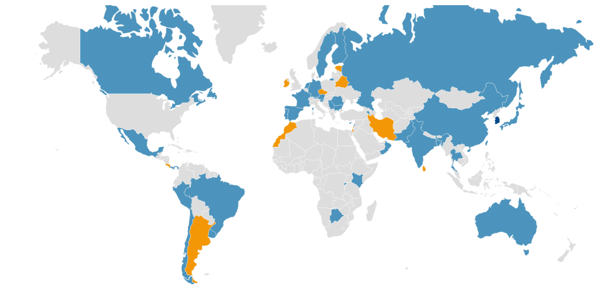
PC 288 members
As of February 2016 - http://www.iso.org/iso/home/about/iso_members.htm

Slide 24

QUESTIONS
Slideshow based on ISO Central Secretariat and ISO/PC 288 generic presentations

